Slide 1
Sublinear Algorithms for Personalized PageRank, with Applications
Ashish Goel
Joint work with Peter Lofgren; Sid Banerjee; C Seshadhri

Slide 2
Personalized PageRank
Assume a directed graph with n nodes and m edges
Notes:
----- Meeting Notes (7/23/15 17:56) -----
Animate

Slide 3
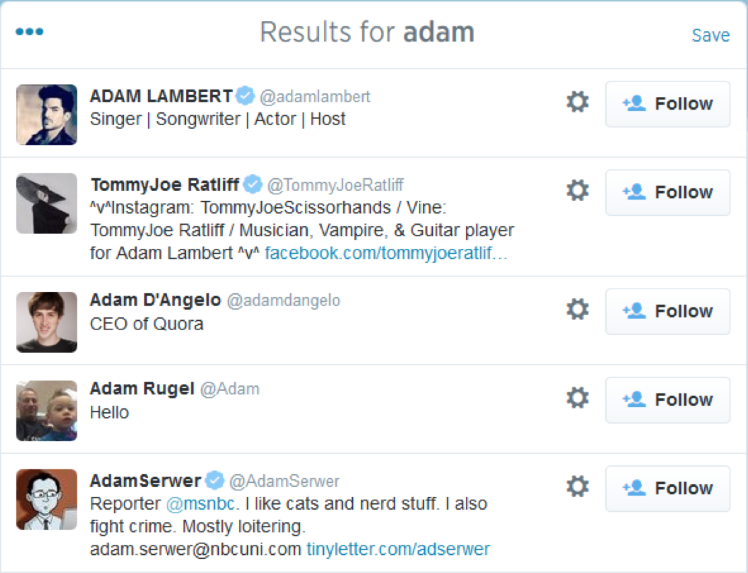
Motivation: Personalized Search
Notes:
Sentence defining PPR

Slide 4
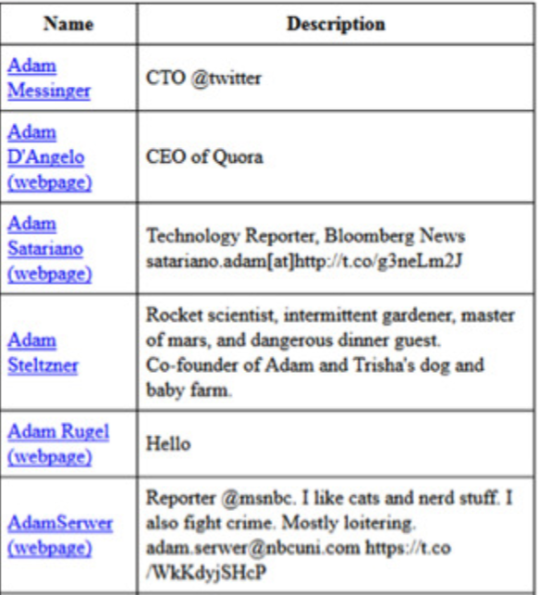
Motivation: Personalized Search
Re-ranked by PPR

Slide 5



Applications
Personalized Web Search [Haveliwala, 2003]
Product Recommendation [Baluja, et al, 2008]
Friend Recommendation (SALSA) [Gupta et al, 2013]
Notes:
----- Meeting Notes (7/23/15 17:56) -----
Another example

Slide 6


Notes:
This screenshot shows my twitter home page. The main view is a collection of tweets from people that I choose to follow. On the left sidebar is a prominent module called ‘Who to follow’ which displays other users that I might want to follow. This module is present in a variety of places throughout Twitter. In fact, we present user recommendations contextually in many other places in the Twitter product.

Slide 7
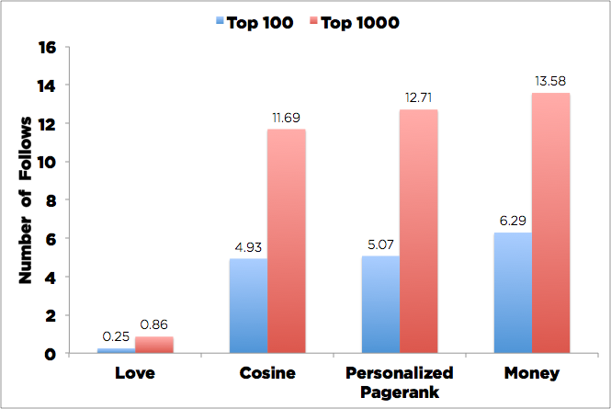
A Dark Test for Twitter’s People Recommendation System
Run various algorithms to predict follows, but don’t display the results. Instead, just observe how many of the top predictions get followed organically
(Money = Personalized PageRank on a bipartite graph; Love = HITS)
[Bahmani, Chowdhury, Goel; 2010]

Slide 8


Promoted Tweets and Promoted Accounts

Slide 9
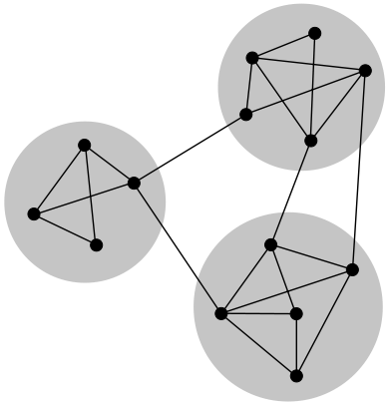
Applications
Community Detection
Personalized PageRank [Yang, Lescovec 2015],[Andersen, Chung, Lang 2006]
Notes:
Say Heat Kernel is a random walk score like PageRank, but it uses a Poisson length distribution rather than Geometric length distribution.

Slide 10
Estimation Goal
Notes:
Transition:

Slide 11
The Challenge
Every user has different score vector: Full pre-computation: O(n²)
Computing from scratch previously took Ω(n) time—several minutes on Twitter-2010

Slide 12
Previous Algorithms Summary
Monte-Carlo: Sample random walks.
(Local) Power-Iteration: Iteratively improve estimates based on recursive equation

Slide 13
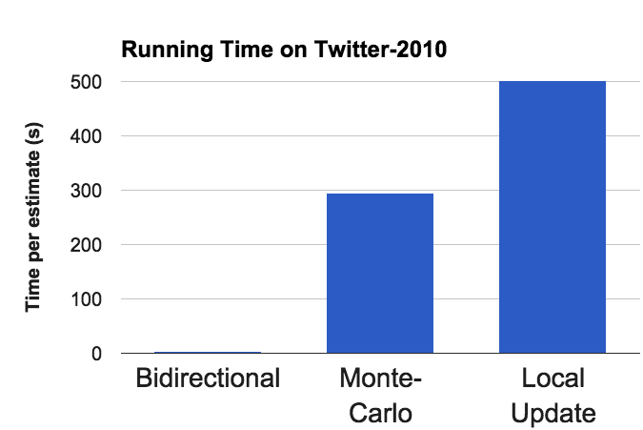
Results Preview (Experiment)
Runtime on Twitter-2010 (1.5 billion edges)
10+ min
6 min
Running Time per Estimate (s)
3s
Bidirectional
Monte-Carlo
Power Iteration
Mean relative error set to ≈10% for all algorithms.
Notes:
Say 120x

Slide 14
Results Preview (Theory)
Task: estimate of size within relative error
Previous Algorithms:
Monte Carlo:
Power Iteration/ Local Update:
Bidirectional Estimator for average target:
# Nodes
# Edges
On Twitter-2010, n=40M, m=1.5B, =40K
Notes:
----- Meeting Notes (7/23/15 17:56) -----
Merge into challenge?

Slide 15
Generalizations
Arbitrary starting distributions. Uniform ⇒ Global PageRank in average time
Other Walk Length Distributions like Heat Kernel (used in community detection [Kloster, Gleich 2014],[Chung 2007]): Our estimator is 100x faster on 4 graphs
Arbitrary Discrete Markov Chain
Notes:
Transpose O(m) time
----- Meeting Notes (7/23/15 17:56) -----
Formulas don't matter
Think of this as more applications

Slide 16
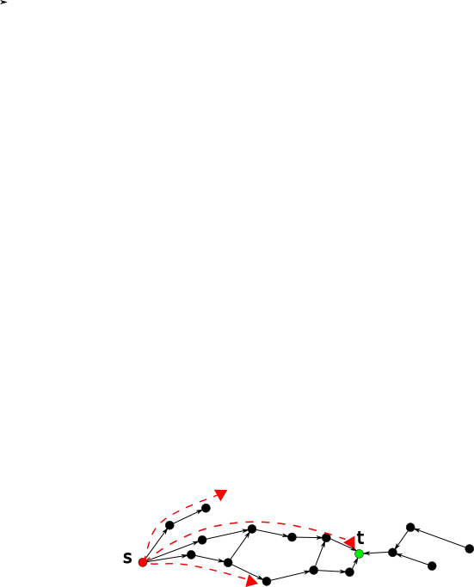
Previous Algorithm: Monte-Carlo
[Avrachenkov, et al 2007]

Slide 17
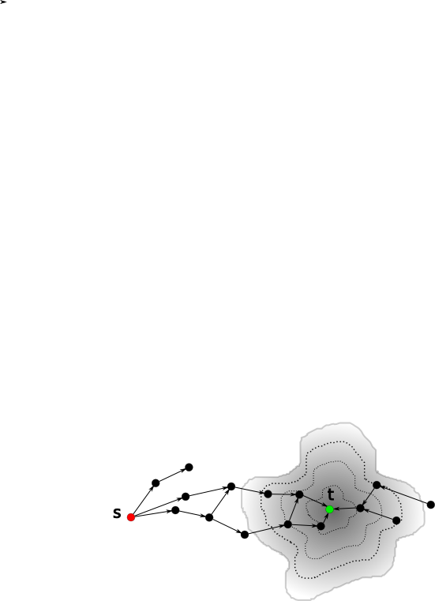
Previous Algorithm: Local Update
[Andersen, et al 2007]
Computes from all s to a single t
Works from t backwards along edges, updating Personalized PageRank estimates locally.
Running time for average t:
Average Degree
Additive Error

Slide 18
Local Update Background
0.2
0.8
Notes:
State they’re equivalent because stationary distribution.

Slide 19
Local Update Example
Notes:
Consider pre-adding alpha*r to p

Slide 20
Local Update Example
Notes:
----- Meeting Notes (7/23/15 17:56) -----
One per slide.
Write equations.
Add box saying r and p are ....
Use previous graph?

Slide 21
Local Update Example

Slide 22
Local Update Example

Slide 23
Local Update Example

Slide 24
Local Update Example

Slide 25
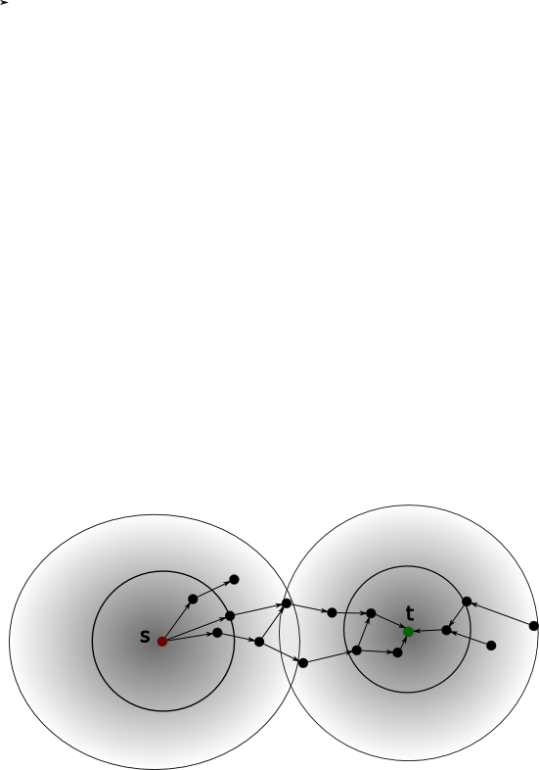
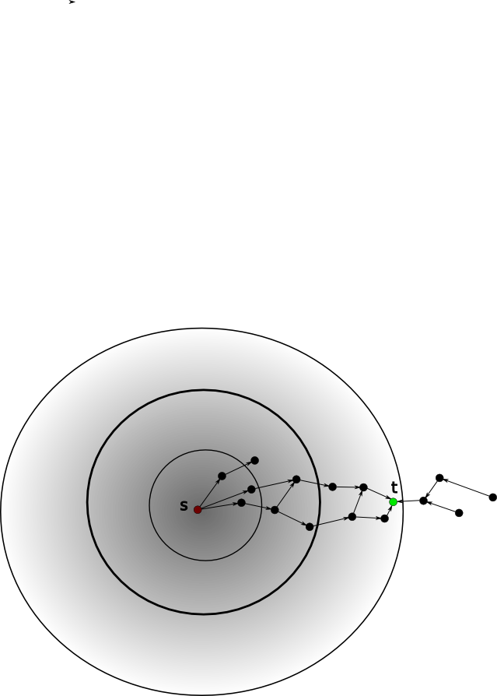
Analogy: Bidirectional Shortest Path
Notes:
For PPR, using path length doesn’t seem to work.

Slide 26
Bidirectional Estimation
The estimates p and residuals r satisfy a loop invariant [Anderson, et al 2007]:
Reinterpret the residuals as an expectation!
Notes:
Describe trade-off for r_max

Slide 27
Bidirectional-PPR Algorithm
Notes:
Draw Picture

Slide 28
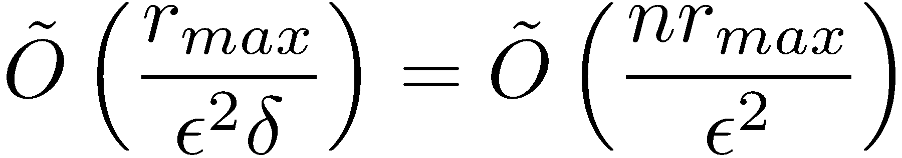
Number of samples
Every walk gives a sample, with
Maximum value r_{max}
Expected value at least ±
Number of walks needed to get a (1 +/- ²)-approximation with high probability =

Slide 29
Bidirectional-PPR Example

Slide 30
Theoretical Results
Notes:
Given any graph $G$, teleport probability $\alpha$, source node (or distribution) $s$, target $t$, FAST-PPR estimates $\pi_s(t)$ of size $\delta$ within relative error $\epsilon$ (with high probability).

Slide 31
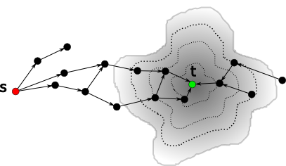
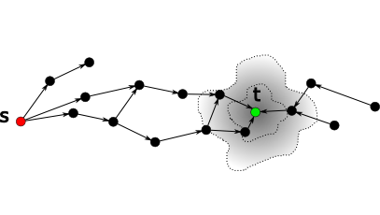
Forward vs Reverse Work Trade-off
u
More Reverse Push Fewer Walks
More Walks Fewer Reverse Pushes
Forward Walks
Reverse Pushes
31

Slide 32
Theoretical Results
Time-Space Trade-off
[Lofgren, Banerjee, Goel, Seshadhri 2014; Lofgren, Banerjee, Goel 2015]
Notes:
Given any graph $G$, teleport probability $\alpha$, source node (or distribution) $s$, target $t$, FAST-PPR estimates $\pi_s(t)$ of size $\delta$ within relative error $\epsilon$ (with high probability).
----- Meeting Notes (7/29/15 18:01) -----
d bar
delta to n

Slide 33
Problem: Unbalanced Forward and Reverse Runtime
1000 s Reverse
0.5 s Forward
Runtime (s)
0.1 ms Reverse
Global PageRank of Target

Slide 34
Heuristic: Balancing Forward and Reverse Runtime
1000 s Reverse
50s Forward
and Reverse
0.5 s Forward
Runtime (s)
Median is 25 ms Forward
and Reverse
0.1 ms Reverse
Global PageRank of Target

Slide 35
Experiments

Slide 36
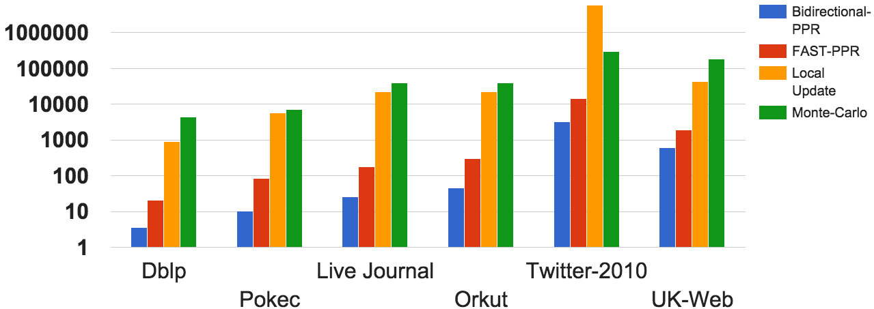
Experimental Results: 70x Faster
Running Time (Targets PageRank)
5min
20s
Running Time per Estimate (ms)
3s
50ms
Mean relative error set to ≈10% for all algorithms.
Notes:
We’re 70x faster on all graphs! On UK 40s -> 0.6s.
Now I’m going to describe how to set an important parameter…

Slide 37
Alternative Estimator for Undirected Graphs
Key property:
We push forwards from s, and take random walks from t.
Notes:
Picture
----- Meeting Notes (7/29/15 18:01) -----
O~(m/epsilon^2)

Slide 38
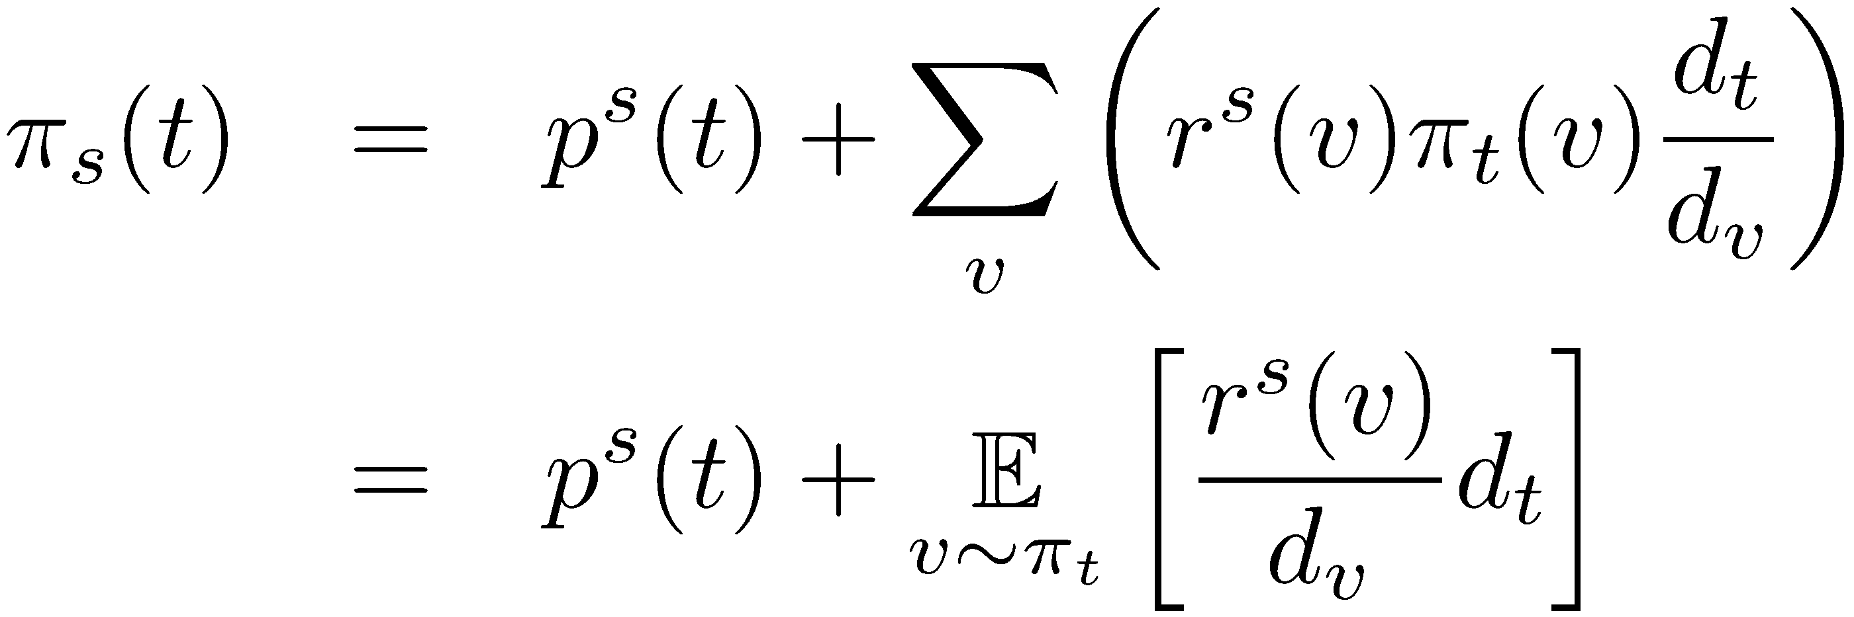
Alternative Algorithm for Undirected Graphs
Loop Invariant of push-forward algorithm [Andersen, Chung, Lang, 2006]
Use symmetry, and then interpret as expectation
Notes:
Push forward, random walks backwards

Slide 39
Alternative Algorithm for Undirected Graphs
Loop Invariant of push-forward algorithm [Andersen, Chung, Lang, 2006]
r_{max}
Use symmetry, and then interpret as expectation
Notes:
Push forward, random walks backwards

Slide 40
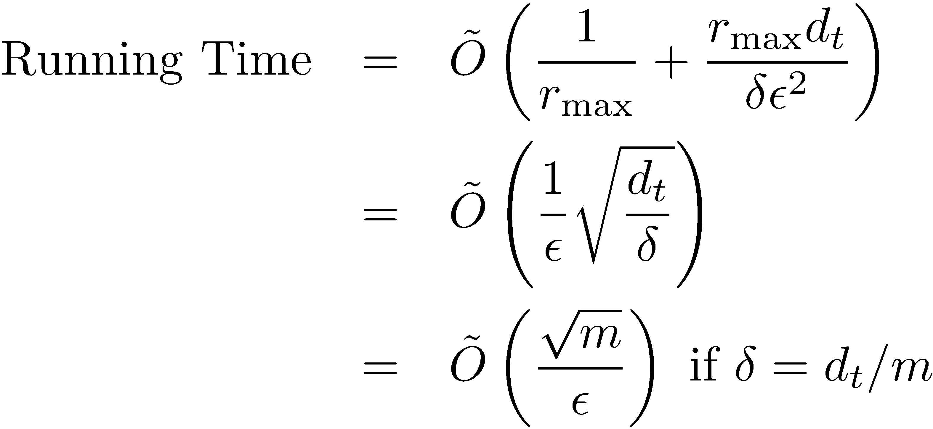
Running time for Undirected Graphs
Notes:
Push forward, random walks backwards

Slide 41
Open Problems
Get rid of the dependence on degree, to get an amortized bound of O(±^{1/2})
Get a worst-case bound of O(m^{1/2}) for directed graphs under the condition that the target has a high global PageRank
Find sharding and sampling algorithms that preserve Personalized PageRank (eg. a sparsifier for Personalized PageRank?)
Build an index around Personalized PageRank to enable network based Personalized Search

Slide 42
Open Problems
Get rid of the dependence on degree, to get an amortized bound of O(±^{1/2})
Get a worst-case bound of O(m^{1/2}) for directed graphs under the condition that the target has a high global PageRank
Find sharding and sampling algorithms that preserve Personalized PageRank (eg. a sparsifier for Personalized PageRank?)
Build an index around Personalized PageRank to enable network based Personalized Search

Slide 43
Personalized Search Problem
Given
A network with nodes (with keywords) and edges (weighted, directed)—Twitter
A query, filtering nodes to a set T— “People named Adam”
A user s (or distribution over nodes) —me
Rank the approximate top-k targets by

Slide 44
Personalized Search Problem
Baselines:
Monte Carlo: Needs many walks to find enough samples within T unless T is very large
Bidirectional-PPR to each t: Slow unless T is small
Challenge: Can we efficiently find top-k for any size of T?
Idea: Modify Bidirectional-PPR to sample in proportion to

Slide 45
Personalized Search Example
a
b
t₁
c
s
t₂
People Named Adam
Searching User
t₃
Expand targets
Random walks
To sample a target:
layer 1: sample (a,b,c) w.p. (0, 10%, 90%)
Layer 2: b→ t₁
c→ sample (t₁, t_{2,} t₃) w.p (56%, 22%, 22%)

Slide 46
Personalized Search Running Time
Runtime on Twitter-2010 (1.5 billion edges)
1000
100
Running Time per Search (s)
10
1
0.1
10
100
1000
10,000
Target Set Size
Precision@3 set to 90% for all algorithms.
Significant Pre-computation (3-30MB per keyword)
Notes:
----- Meeting Notes (7/29/15 18:01) -----
log scale point

Slide 47
Personalized Search Result

Slide 48
Demo

Slide 49
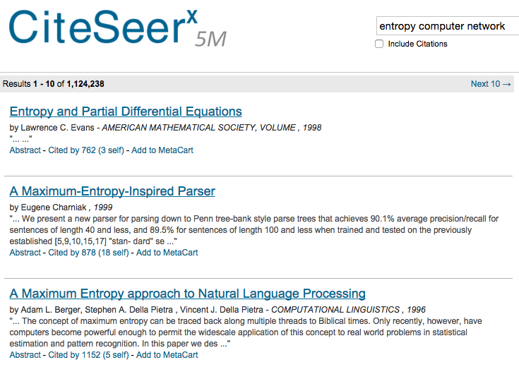

Slide 50
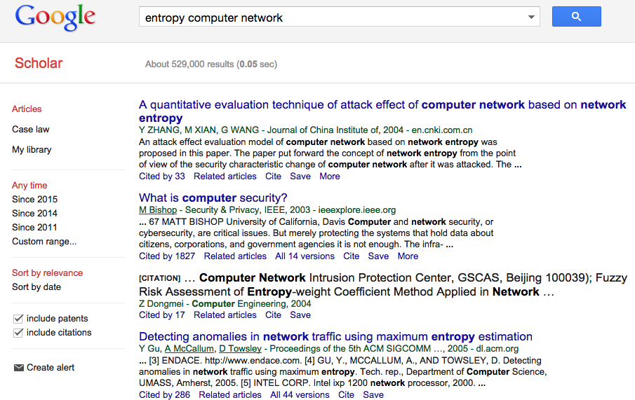

Slide 51
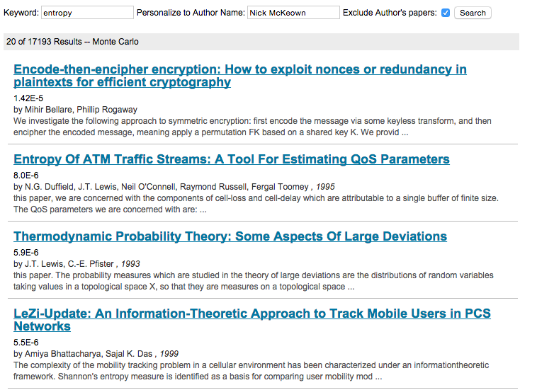
Demo
Task: Find applications of entropy in computer networking.
personalizedsearchdemo.com

Slide 52
Distributed PageRank
Problem: Computing PageRank on graph too large for one machine.
Algorithm:
Shard edges randomly,
compute on each machine
average results
Basic idea: Duplicate edges from low-degree nodes. Gives an unbiased* estimator.
Notes:
----- Meeting Notes (7/27/15 17:50) -----
Explain why communication is expensive.

Slide 53
Sharded Global PageRank Accuracy on Twitter-2010
L1 Error
Min Degree Parameter
Average 2.1x Duplication
No Edge Duplication
Notes:
Mean relative error?

